Slide 1
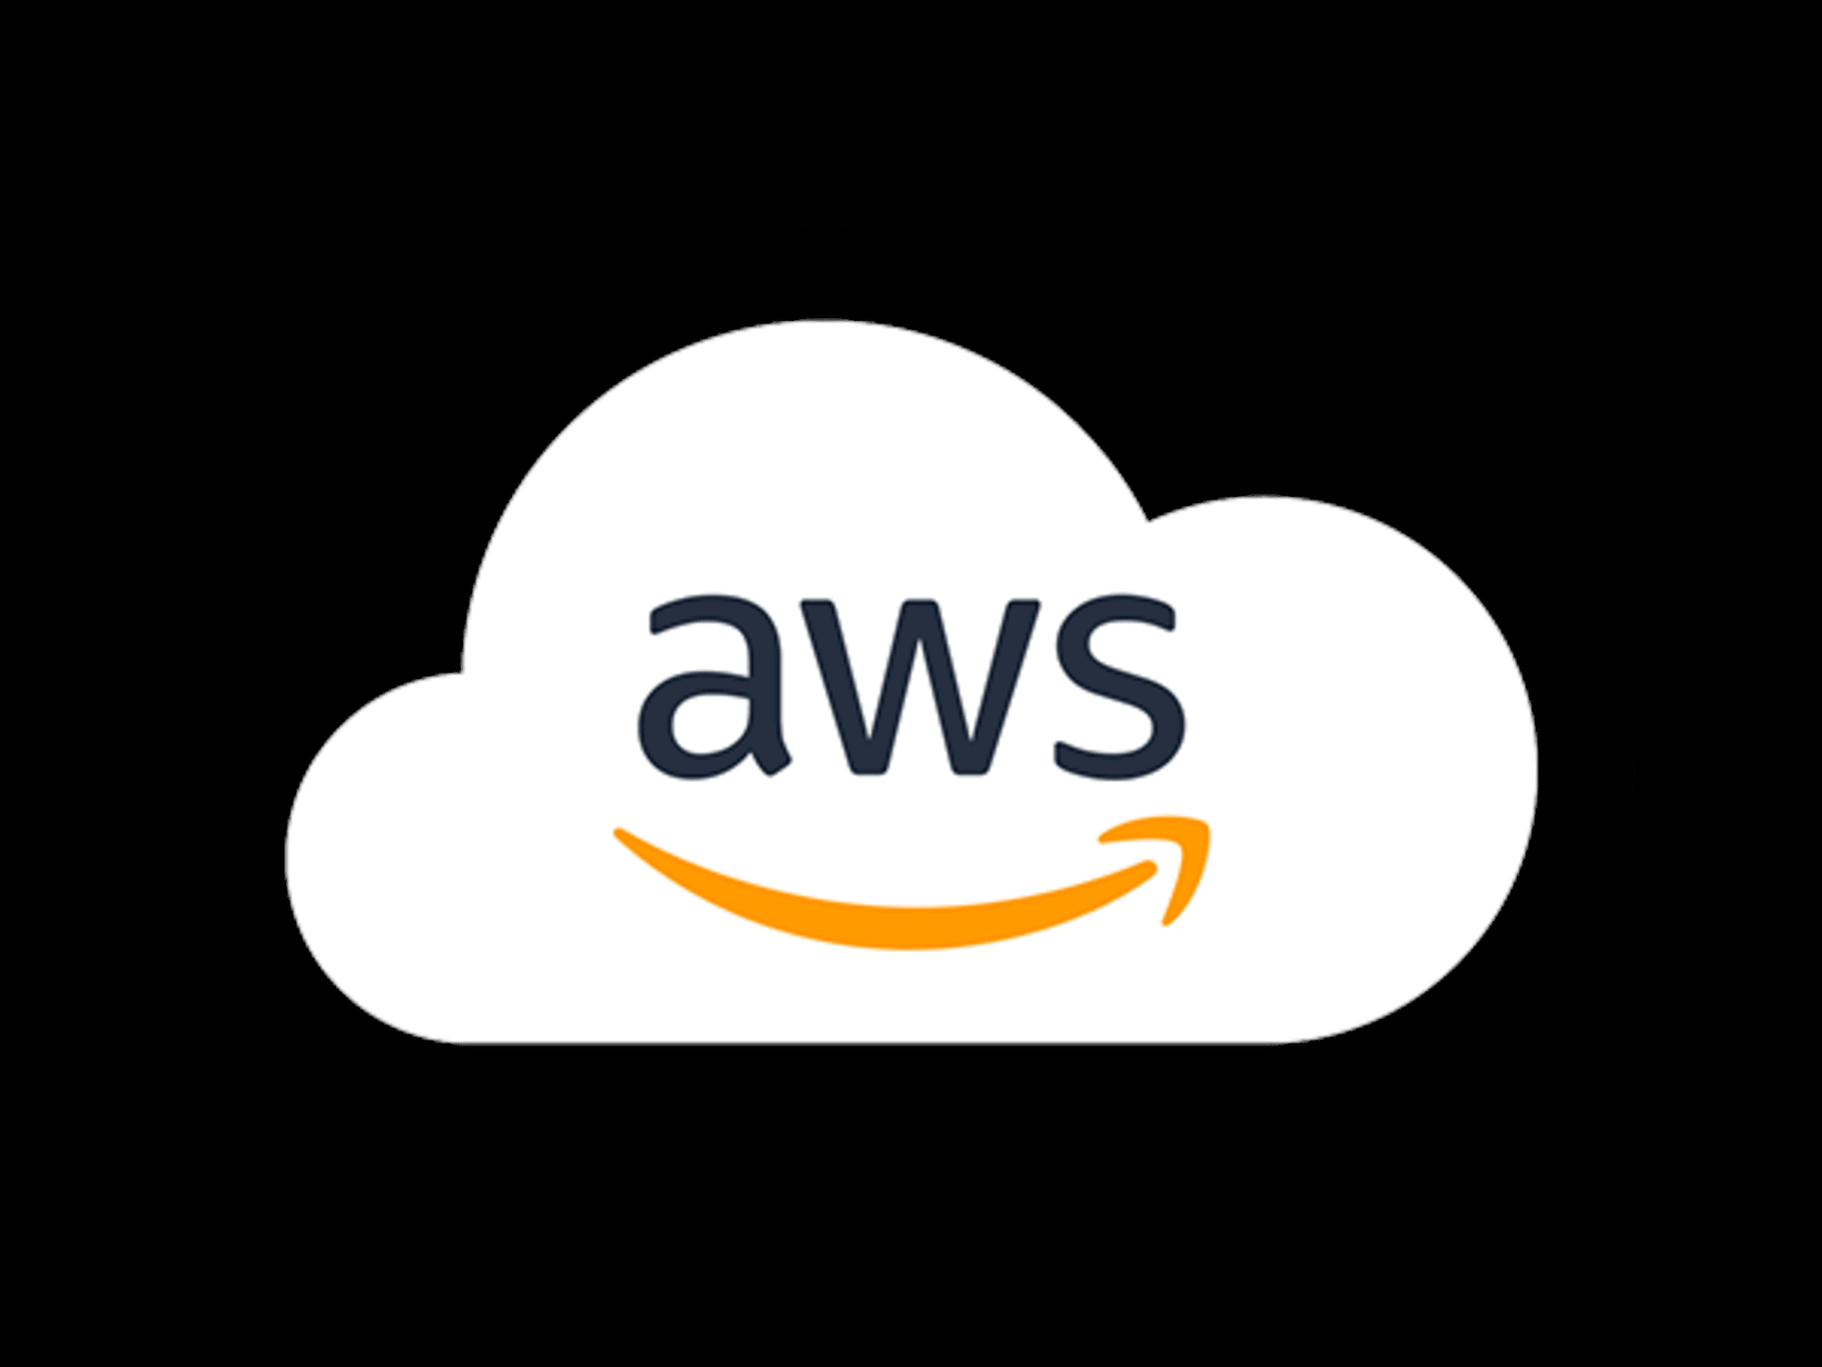

Slide 2
What is cloud ?
Cloud computing means storing and accessing data and programs over the internet instead of your computer's hard drive.

Slide 3
What are the main service models of cloud computing?
Software-as-a-Service (SaaS): Instead of users installing an application on their device, SaaS applications are hosted on cloud servers, and users access them over the Internet. SaaS is like renting a house: the landlord maintains the house, but the tenant mostly gets to use it as if they owned it. Examples of SaaS applications include Salesforce, MailChimp, and Slack.
Platform-as-a-Service (PaaS): In this model, companies don't pay for hosted applications; instead they pay for the things they need to build their own applications. PaaS vendors offer everything necessary for building an application, including development tools, infrastructure, and operating systems, over the Internet. PaaS can be compared to renting all the tools and equipment necessary for building a house, instead of renting the house itself. PaaS examples include Heroku and Microsoft Azure.
Infrastructure-as-a-Service (IaaS): In this model, a company rents the servers and storage they need from a cloud provider. They then use that cloud infrastructure to build their applications. IaaS is like a company leasing a plot of land on which they can build whatever they want — but they need to provide their own building equipment and materials. IaaS providers include DigitalOcean, Google Compute Engine, and OpenStack.

Slide 4
Who is Amazon
American International MultiBillion Dollar Electronic commerce company with Headquarters in seattle ,washington ,USA
Started in 1995 by jeff bezos as an online book store .
In 2006 Amazon launched the Amazon Web Service (AWS) to become a major provider of Cloud Computing Services

Slide 5
What is Amazon web Services
Amazon web services (AWS) is a collection of remote computing services (web services) that together make a cloud computing platform offered over the Internet by Amazon.com
Website : https://aws.amazon.com
Aws is located in 9 geographical regions . Each region is wholly contained within a single country and all of its data and services stay within a Designated region . Each region has multiple Availability zone which are Distinct data Centers providing AWS Services .

Slide 6
What is AWS offering ?
Low on going cost : pay–as-you –go pricing no up-front expenses or long term Expenses.
Instant elasticity and flexible capacity (Scaling up and down) : eliminate guessing on your infrastructure capacity needs .
Speed and Agility : Develop and Deploy Application Faster instead of waiting weeks or months for hardware to arrive and get installed .
Apps not ops : Focus on projects. Lets you shift resources awau from data center investments and operations and move them to innovative new projects .
Global reach : Takes your Applications globally in minutes .
Secure : Allows you Application to take Advantage of multiple layers of operational and physical security in the Aws data centers to ensure the data integrity and safety of your data .

Slide 7
Infrastructure Services

Slide 8
Amazon Elastic compute cloud (EC2)
An Amazon EC2 instance is a virtual server in Amazon's Elastic Compute Cloud (EC2) for running applications on the Amazon Web Services (AWS) infrastructure. AWS is a comprehensive, evolving cloud computing platform; EC2 is a service that enables business subscribers to run application programs in the computing environment. A web service that provides resizable compute capacity in the cloud.
EC2 allows creating Virtual Machines (VM) on-demand.
Auto Scaling allows automatically scale of the capacity up seamlessly during demand spikes to maintain performance, and scales down during demand lulls to minimize costs.
Elastic Load Balancing automatically distributes incoming application traffic across multiple Amazon EC2 instances.
Amazon provides various types of instances with different configurations of CPU, memory, storage and networking resources to suit user needs. Each type is available in various sizes to address specific workload requirements.

Slide 9
Amazon Elastic Block Store (EBS)
Provides block level storage volumes (upto 1 Gb to 1 Tb) for use with Amazon EC2 Instances.
- Muliple volumes can be mounted to the same instance .
- EBS volumes are network-attached, and persist independently from the life of an instance.
EBS volumes are placed in a specific Availability Zone, and can then be attached to instances also in that same Availability Zone.
Each storage volume is automatically replicated within the same Availability Zone.
EBS provides the ability to create point-in-time snapshots of volumes, which are persisted to Amazon S3.
These snapshots can be copied across AWS regions.

Slide 10
Amazon Simple Storage Service (S3)
Amazon S3 provides a simple web services interface that can be used to store and retrieve any amount of data, at any time, from anywhere on the web.
In S3 Data will be stored in the form object .
In s3 we can Write, read, and delete objects containing from 1 byte to 5 terabytes of data each. The number of objects you can store is unlimited.
Each object is stored in a bucket and retrieved via a unique, developer-assigned key.
A bucket can be stored in one of several Regions.
Objects can be made private or public, and rights can be granted to specific users.
S3 charges based on per GB-month and per I/O requests and per data modification requests.

Slide 11
Thank You

